Slide 1
Software Testing Methodologies
Prashant Joshi

Slide 2
Math for Test Engineers
For Test Engineers – Know our focus
Testing is a craft; math are the craftsman’s tools
Bring Rigor, Precision and Efficiency
Our treatment of math
Largely informal – What is required for Test Engineers and not for mathematicians
Our focus is discrete mathematics
Aim is
To make test engineers better at their craft

Slide 3


Permutation
Choosing r things out of n
Repetition
n possibilities for each of the r choices
Without Repetition
Possibilities reduce with every selection
$$n^{r}$$
$$\frac{n!}{\left(n−r\right)!}$$

Slide 4


Combination
Choosing r things out of n
Repetition allowed
Without Repetition
$$\frac{\left(n+r−1\right)!}{r!\left(n−1\right)!}$$
$$\frac{n!}{r!\left(n−r\right)!}$$

Slide 5
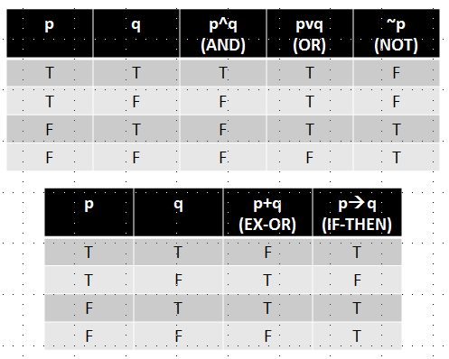
Propositional Logic

Slide 6
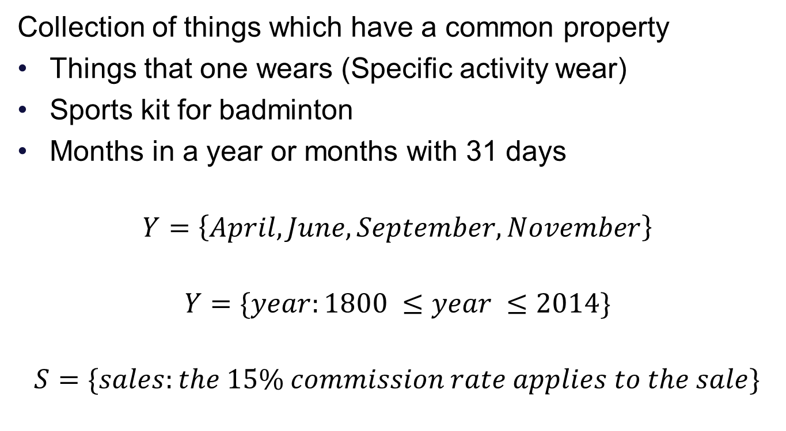
Set Theory
Collection of things which have a common property
Things that one wears (Specific activity wear)
Sports kit for badminton
Months in a year or months with 31 days
$$Y=\left\{April, June, September, November\right\}$$
$$Y=\{year:1800 ≤year ≤2014\}$$
$$S=\{sales:the 15\% commission rate applies to the sale\}$$
Listing Elements
Decision rule
Decision rule

Slide 7
Venn Diagrams
Picture(s) for Sets
A set of depicted as a circle with interior of the circle corresponds to the elements of the set
U
April
November
September
June
Venn diagram of 30 day month

Slide 8
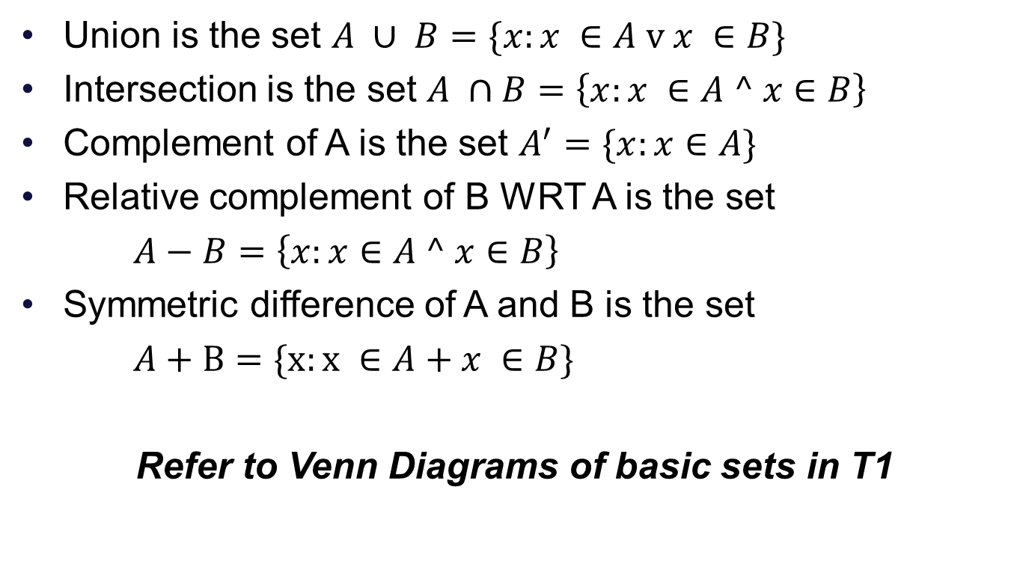
Set Operations
Union is the set $A ∪ B=\{x:x ∈A \text{v} x ∈B\}$
Intersection is the set $A ∩B=\left\{x:x ∈A ^ x∈B\right\}$
Complement of A is the set $A^{′}=\{x:x∈A\}$
Relative complement of B WRT A is the set
$A−B=\left\{x:x∈A ^ x∈B\right\}$
Symmetric difference of A and B is the set
$A+B=\{x:x ∈A+x ∈B\}$
Refer to Venn Diagrams of basic sets in T1

Slide 9

Set Operations
Unordered pair $(a, b)$
Ordered pair $<a, b>$
What is the difference?
Cartesian Product
$$A ×B=\{<x, y>:x ∈A ^ y ∈B\}$$

Slide 10
Set Relations
Subset
A is subset of B if and only if all elements of A are also in B
Proper subset
A is a proper subset of B if and only if there is at least one element in B which is not in A
Equal Sets
Each is a subset of the other
Look up the notations in the book T1 Chapter 3

Slide 11
Graph
A graph (also known as linear Graph) is an abstract mathematical structure defined from two sets – set of nodes and set of edges that form connections between nodes
Example: Computer Network
Definition
A Graph G = (V,E) is composed of a finite (and nonempty) set V of nodes and a set of E of unordered pairs of nodes

Slide 12
A Graph
Nodes and Edges Sets
Connection between nodes
n1
n2
n5
e1
e4
e2
n3
n3
n7
e3
e5
n6

Slide 13
Use of representation
Nodes as program statements
Edges
Flow of control
Define/use relationships

Slide 14
Use of Degree of Node
Indicates Popularity
Social scientists
Social interactions
Friendship/communicates with
Example:
Graph with nodes are objects and edges are messages; degree can represent the extent of integration testing that is appropriate for the object

Slide 15
Incidence Matrix
The incidence matrix is a graph G=(V,E) with m nodes and n edges is a m x n matrix, where the element in row i, column j is a 1 if and only if node i is an endpoint of edge j; otherwise the element is 0
 | e1 | e2 | e3 | e4 | e5
n1 | 1 | 1 | 0 | 0 | 0
n2 | 1 | 0 | 0 | 1 | 0
n3 | 0 | 0 | 1 | 0 | 0
n4 | 0 | 1 | 1 | 0 | 1
n5 | 0 | 0 | 0 | 1 | 0
n6 | 0 | 0 | 0 | 0 | 1
n7 | 0 | 0 | 0 | 0 | 0

Slide 16
Use of this representation
Degree of node is zero
Unreachable node

Slide 17
Adjacency Matrix
Deals with connections
The adjacency matrix of a Graph G=(V,E) with m nodes is an m x m matrix, where the element in row i, column j is 1 if and only if an edge exists between node i and node j; otherwise, the element is 0
 | n1 | n2 | n3 | n4 | n5 | N6 | n7
n1 | 0 | 1 | 0 | 1 | 0 | 0 | 0
n2 | 1 | 0 | 0 | 0 | 1 | 0 | 0
n3 | 0 | 0 | 0 | 1 | 0 | 0 | 0
n4 | 1 | 0 | 1 | 0 | 0 | 1 | 0
n5 | 0 | 1 | 0 | 0 | 0 | 0 | 0
n6 | 0 | 0 | 0 | 1 | 0 | 0 | 0
n7 | 0 | 0 | 0 | 0 | 0 | 0 | 0

Slide 18
Use of this representation
Deals with connections
Useful for later graph theory concepts example: paths

Slide 19
Paths
A path is a sequence of edges such that for any adjacent pair of edges e_{i}, e_{j} in the sequence, the edges share a common (node) endpoint
Path | Node Sequence | Edge Sequence
Between n1 and n5 | n1, n2, n5 | e1, e4
Between n6 and n5 | n6, n4, n1, n2, n5 | e5, e2, e1, e4
Between n3 and n2 | n3, n4, n1, n2 | e3, e2, e1

Slide 20
Graph
n1
n1 represents a series of statements
n7 also represents a series of statement
Is this the correct representation?
How does this help us get to testing?
What does this help in?
n2
n3
n4
n5
n6
n7

Slide 21
Software Testing Methodologies
Prashant Joshi

